Slide 1
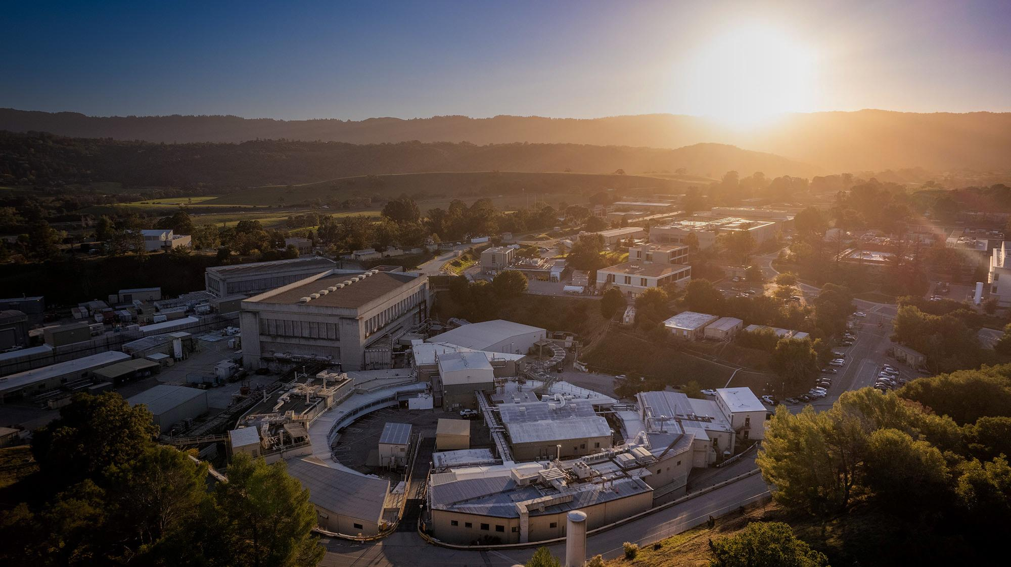
Sequoia –
Our New HR System
Overview | August 2025

Slide 2
Background

Slide 3
What is changing?
Comprehensive effort to modernize HR at Stanford, inclusive of SLAC. This effort includes:
Implementation of a new cloud-based technology platform
Enhancements to compensation administration practices and culture
Creation of an HR service center for employee and manager support
Unification of performance management practices across Stanford’s schools and units
Notes:
There is a comprehensive effort to modernize HR at Stanford.
This effort includes changes to HR and Payroll technology, the creation of an HR service center to support employees and managers with HR-related transactions, and adjustments to some HR program and processes
The two primary programs being updated through Pinnacle are Stanford’s performance management program and Stanford’s approach to compensation administration.

Slide 4
Why are we making changes?
A Necessary Action:
Our end-of-life HR and Payroll system (PeopleSoft) must be replaced.
A Technology Upgrade:
We are implementing Oracle’s newest cloud-based HR system, branded “Sequoia” for Stanford.
A Forcing Function:
Sequoia cannot support our current varied ways of operating across schools and units.
An Opportunity:
The new system creates an opportunity for the university to have greater consistency, streamlined HR processes that better support all employees

Slide 5
Benefits of Standard Processes and Technology
Consistency in Sequoia ensures system integrity, enables scalability, reduces costs, and provides a seamless, equitable employee experience.
Simplification and Reduced Friction
Eliminates unnecessary complexity, streamlines workflows, and reduces friction
Future Proofing
Adopt system updates and innovations without extensive rework
Improved Decision-Making
Consistent, reliable data, enabling better analytics and more informed decisions
Stronger Governance and Compliance
Reduced institutional risk by promoting adherence to policies and regulatory requirements
Enhanced Collaboration and Cross-functional Alignment
Shared processes foster alignment and enable easy, effective collaboration
Employee Mobility
Enables easier employee transitions between roles and units, enhancing internal career development opportunities
Streamlined Onboarding
A uniform approach simplifies new hire onboarding and reduces the learning curve
Notes:
Benefits of Consistency
Consistency is critical to the success of Sequoia, and cloud-based technology solutions in general, because it ensures system integrity, enables scalability, reduces costs, and provides a seamless, equitable experience for all employees.
Simplification and Reduced Friction: Standardizing processes eliminates unnecessary complexity, streamlines workflows, and reduces friction, making it easier for employees, managers, and HR colleagues to navigate Sequoia and perform tasks efficiently.
Improved decision making: Standardized processes provide consistent, reliable data across the organization, enabling better analytics and more informed decisions.
Enhanced collaboration: Shared processes foster cross-functional alignment and make it easier for teams to work together effectively within S/Us and across Stanford.
Streamlined onboarding: A uniform approach simplifies onboarding for new employees and reduces the learning curve.
Future proofing: Standardization makes it easier to adopt system updates and innovations without extensive rework.
Stronger governance and compliance: Consistent processes reduce institutional risk by promoting adherence to policies and regulatory requirements.
Employee mobility: Standardized systems allow employees to transition between roles and units more easily, enhancing internal career development opportunities.

Slide 6
The Sequoia experience
Sequoia is designed to support easy, direct access for employees and managers to HR-related needs. It is an innovative platform that will streamline processes, enhance user experiences, and ensure data security.
Direct access to HR-related needs
User-Friendly Interface
Seamless Integration
Connected Resources
Notes:
Direct access to all your HR-related needs
The new system will provide access to personal information updates, performance management, training and development resources, timecard approval and submissions, payroll information, and more. This comprehensive suite ensures that everything from managing your career progression to handling day-to-day HR tasks is seamless and intuitive, all within a single, user-friendly platform.
User-friendly interface
The new system will welcome you with an intuitive homepage featuring tiles representing different categories and tasks. Whether you need to update your personal information, approve timecards, or access other HR-related resources, each tile is clearly labeled and easy to navigate. This modern and simplified interface directs you to the appropriate sources and supporting information, making it quick and easy to complete tasks efficiently. Many of these can be directly accessed without needing support from HR.
Seamless Integration
The system structure has been thoughtfully built to simplify processes, including direct access structures. You’ll find that accessing your HR-related needs has never been easier. The new system will be accessible through a dedicated portal, providing a centralized hub for all HR-related activities.
Connected Resources
The new system doesn’t just stop at HR and payroll tasks. It will link to additional resources outside of the portal as needed, ensuring you have all the information you need for your role at your fingertips.

Slide 7
When will Sequoia Go Live?
January 2026
Mar. | Apr. | May | June | July | Aug. | Sept. | Oct. | Nov. | Dec. | Jan 2026 | Feb 2026
System Testing
Final
Review
Cutover
Hypercare (Intensive Support)
HR Communications
HR Training
Employee Communications
All Employee Communication
Web-based Training for Managers, Employees, Faculty
Introducing Sequoia
5 Things to Expect
The Story Behind the Name
What training and support resources will look like
High-level overview of experience changes by functional areas
Overview of manager role experience shifts (managers only)
Role-based information about what’s changing
Step-by-step guidance, training, and support resources
Notes:
SIT2 is in progress
Train the Trainer Status
CRA: Manager CRA closed; CRA for HR Community will go out mid-late June

Slide 8
What Employees Will Experience

Slide 9












What Will Sequoia Do?
Basic Employee Data
Job Information
Direct Access
Performance Management
Compensation
Talent Acquisition
Talent Management
Time and Absence Management
Payroll
What other systems will change, or go away?
HR
SLAC
Performance Tool

Slide 10
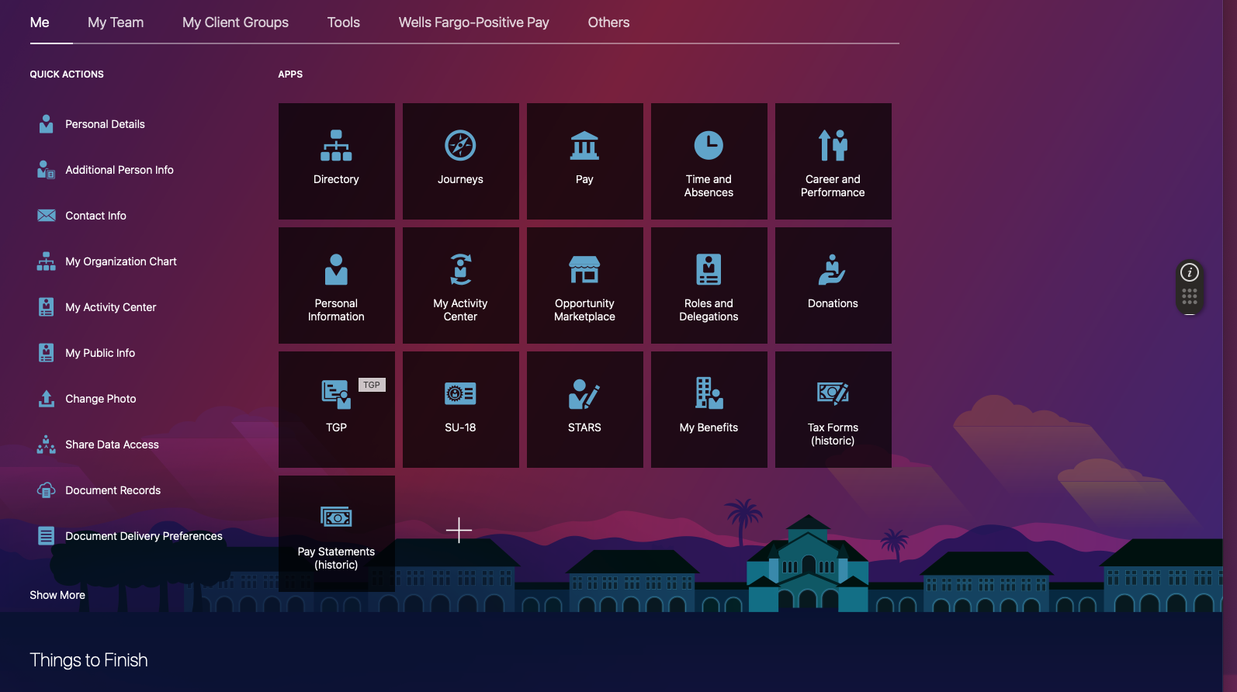
Tiles
For commonly used functions & links to other systems
Notes:
The Landing Page/Springboard:
The New Direct Access Landing Page is replacing the current AXESS portal where Employees, Managers & HR interact with the current HR Application
Me – The ME Tab is the new Employee Direct Access page where employees can view their information and perform employee specific Transactions
My Team – The My Team Tab is the new Manager Direct Access page where managers can view information about their Direct and Indirect reports and perform Manager specific transactions
My Client Group – The My Client Group Tab is the new HR Direct Access page where HR professionals can view information about employees within their area of responsibility and perform HR transactions

Slide 11
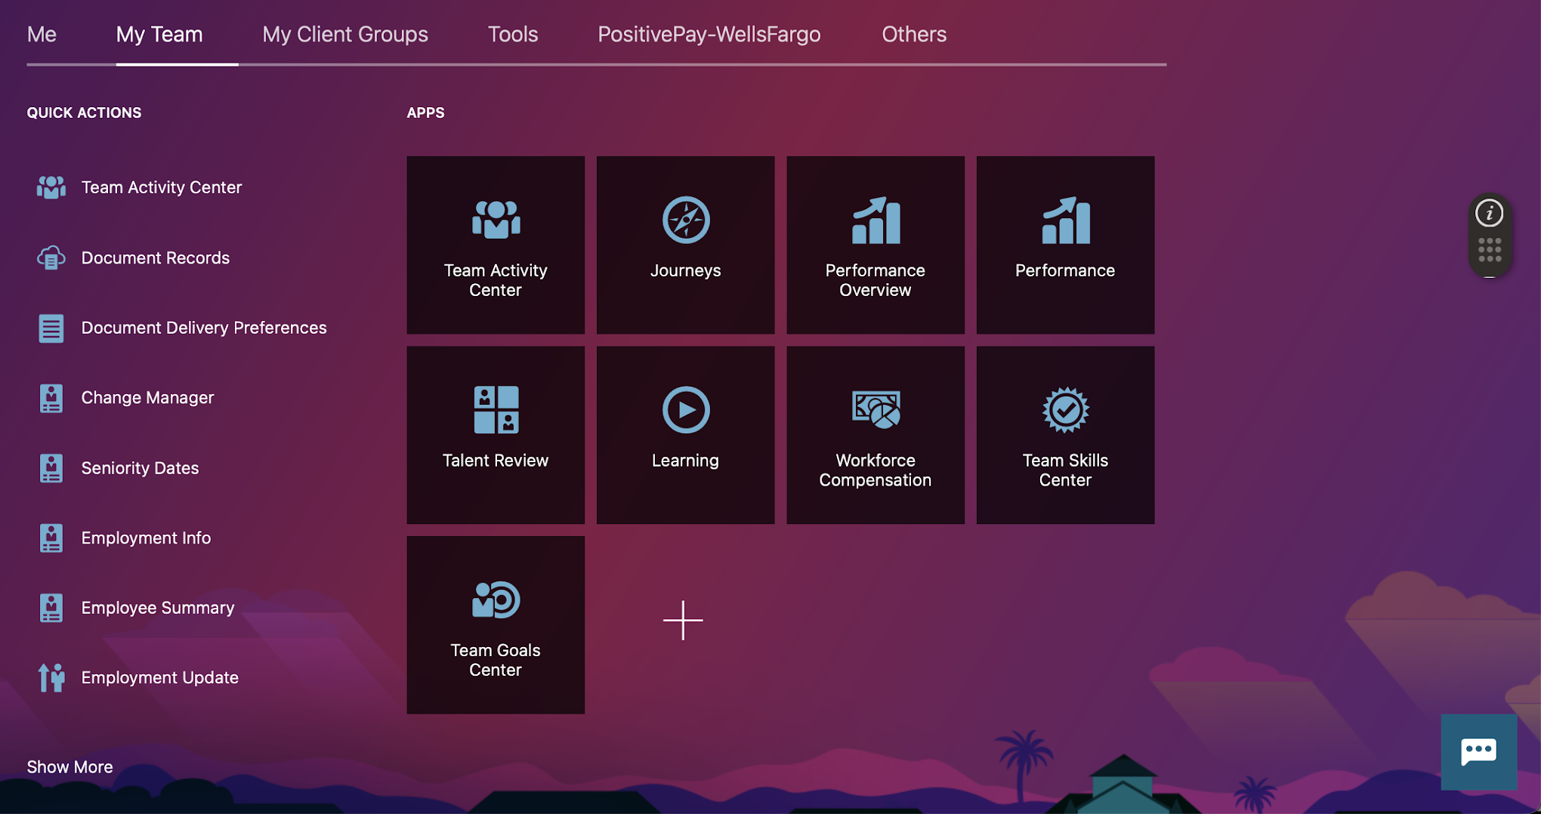
For Managers
Tiles
For commonly used functions & links to other systems
Notes:
The Landing Page/Springboard:
The New Direct Access Landing Page is replacing the current AXESS portal where Employees, Managers & HR interact with the current HR Application
Me – The ME Tab is the new Employee Direct Access page where employees can view their information and perform employee specific Transactions
My Team – The My Team Tab is the new Manager Direct Access page where managers can view information about their Direct and Indirect reports and perform Manager specific transactions
My Client Group – The My Client Group Tab is the new HR Direct Access page where HR professionals can view information about employees within their area of responsibility and perform HR transactions

Slide 12
Manager Experience | Empowerment and Access
Stanford is providing greater transparency and direct access to essential tools and data, empowering you to focus on developing your team, achieving results, and making informed decisions, giving you the time and tools you need to lead effectively and make a meaningful impact.
Managers will have visibility to compensation data for their direct reports, including historical pay information.
Managers will play a role in the standard approval path for compensation actions (approval will typically go to a requester’s manager, and HR, with an option for local Finance approval, and UHR Compensation approval if outside of thresholds).
Managers will actively manage their teams by evaluating performance, making compensation allocation recommendations, and initiating job offers and promotions of direct reports.
Managers will be able to reward performance by recommending variable and ad-hoc compensation (e.g. increases, spot awards, bonuses).
Managers will engage in meaningful conversations when communicating compensation change to direct reports.
Clicks don’t replace conversations – local HR will continue to partner strategically with managers and leaders. Plus, guardrails, alerts, notifications and approval pathways within our new HR and Payroll system will prevent accidental or inappropriate actions.
Managers will have the ability to make updates to direct reports’ data via direct access, streamlining the process.
Managers will have the option to delegate most system interactions (for certain managers like faculty and senior leaders; all managers may delegate during time away or leaves of absence).

Slide 13
Employee Experience | Direct Access and Support
Stanford is providing consistent support across the university, bringing you tools to handle HR tasks quickly and accurately — creating more time and energy to focus on what inspires you while contributing to Stanford’s mission.
Employees will have increased visibility to their employment data and ability to highlight competencies, qualifications, licenses and certifications, and honors and awards through their talent profiles.
Employees will have a wider selection of options for self-service information management including updating their demographic information and requesting leaves of absences.
Employees will have access to enhanced, consistent HR support through the HR Service Center team. Details of the structure and function of this team are currently under development.
Employees will experience simplified internal mobility through consistent tools, access to information, support processes, performance management practices, etc.
Building a thoughtful and well-support transition experience for employees with straightforward training and support.
Employees will be guided through onboarding or offboarding virtual journeys that will streamline their experience and guide them through the processes.

Slide 14
SLAC HR System Change Champions
AD | Diane Kelley Sung Kwon
BSD | Alex Ho Analisa Tan
Directors Office (All Depts) | Elizabeth Trokey Oliver Lopez
ESH | Terry McMahon
F&O | Reyna Gaoaen Shane Wells Tria Xiong
LCLS | Brittany Yee Gail Fong
SSRL | Stephanie Carlson
TID | Mike Gonzalez Samantha Thurman
HR | Arabella Salas Dayle Mahoney Denishi Blake Eric Shupert Erin Coley Gina Bagley Mark Lorenz Mary Bielenberg Shon Hansen
IT | Shannon Sayler
OPM | Matt Vivian
SC&EA | Mel O'Keefe
ESD | Amita Gupta Michelle Young
FPD | Christine Soldahl

Slide 15
For More Information ….
SSRL Sequoia Change Champion Stephanie Carlson HR Colleagues / Change Champions HR Business Partner: Arabella Salas Change Mgmt Lead: Mark Lorenz Cardinal at Work Introducing Sequoia 5 Things to Expect The Story Behind the Name

