Slide 1
SSRL Town Hall
August 6, 2025

Slide 2
Outline
Summary message
Parking situation B137 lot
SSRL new hires
Arabella Salas (HR BP): Kick-off for performance evaluation season
Mark Lorenz (SLAC HR): Sequoia update
Neal Adams (IT BP): Windows11, Yubikeys, Office 365 updates

Slide 3
Summary message
Thank you for your engagement in Safety Moment at SLAC
  Please continue to pause, report, and ensure we’re ready to perform work
  Three themes, which we’ll discuss more broadly: Operational Systems; Human Factors;
  Infrastructure Challenges
Enhanced financial controls consistent with budget outlook and uncertainty remain a priority
  SLAC is exploring various scenarios to further reduce costs and enhance programmatic
  buying power while remaining committed to priority investments
  Stanford is taking steps consistent with fiscally constrained budget; relatively limited
  impact on SLAC
  Direct budget remains uncertain; SMT retreat will develop initial indirect plan mid-August
Next SLAC Town Hall – 8/21; next SSRL All Hands – 9/2

Slide 4
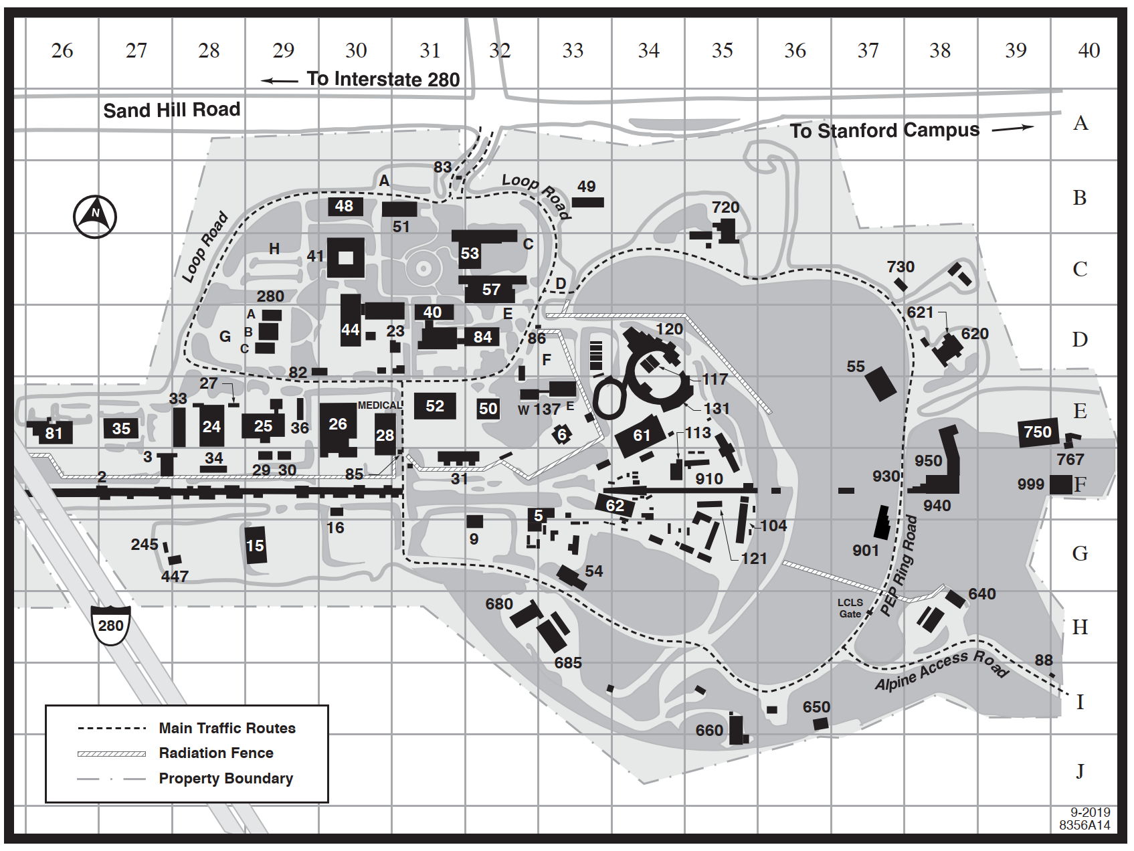
Parking situation B137 lot
LSCC construction staging – starts end of this month
  Will result in loss of ~ 90 spots in the B137 parking lot
  Project will affect parking near SSRL for the next two years
SLAC is clearing the 280 lot to provide additional parking on campus
  We have requested restriping of B006 lot and of “motorcycle corral” near Verve,
  which would provide > 30 additional spots
  Parking near SSRL will be challenging

Slide 5
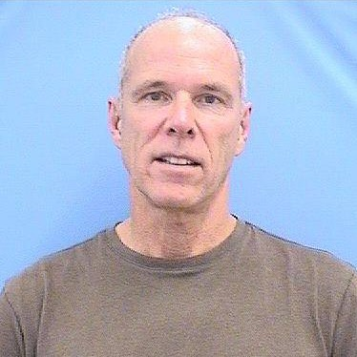
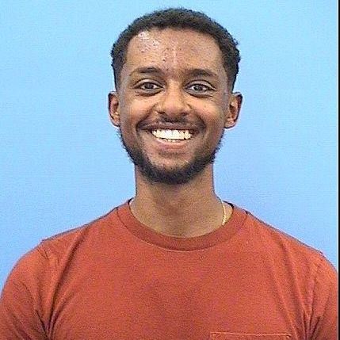
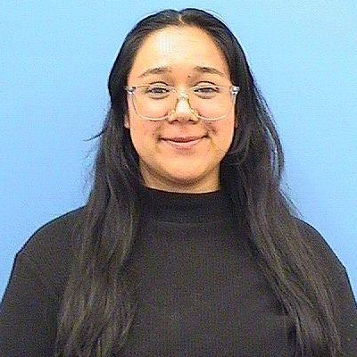
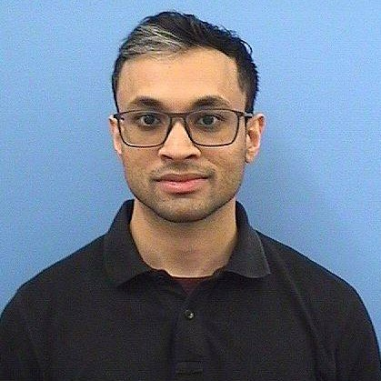
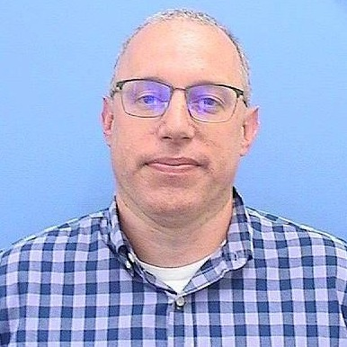
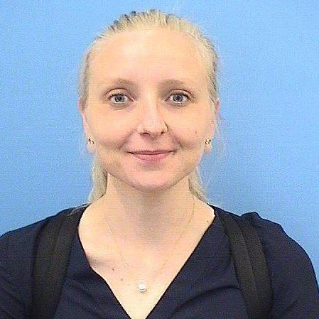
SSRL New Hires
June- July 2025
Greg Portmann
Accelerator Physics
Temesgen Worku
MSD Engineering
Alma Santiago
MSD Hard X-Rays
Aniruddha Bhattacharjee
Director’s Office
Microelectronics
Rob Lion
Accelerator Mechanical Systems
Anna Wanhala
MSD Hard X-Rays

Slide 6
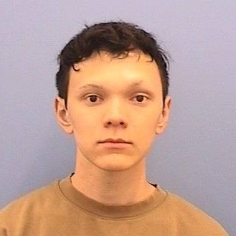
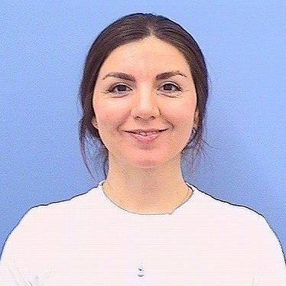
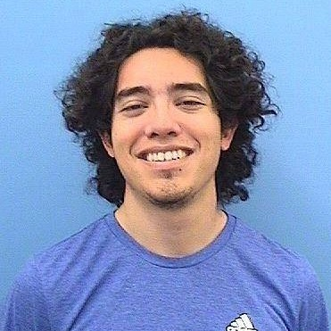
SSRL New Hires
Yaxel Perez
Protection Systems
Quincy Owyang
XAS Beam Line Operations
Ozge Bozkurt
Catalysis/Chemistry XAS

Slide 7
?

