Slide 1
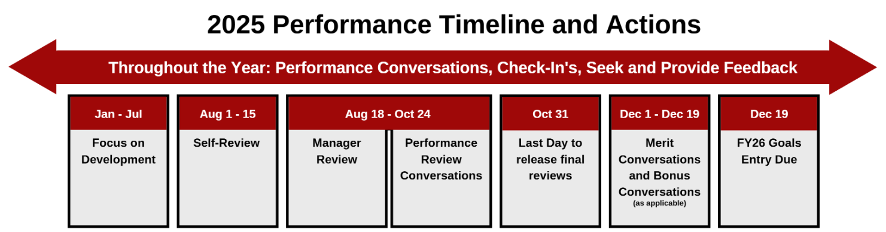
Performance Reviews: August 1 – October 31

Slide 2
Performance Review Training - All Live
Title | Audience | Duration
Employee Performance Tool Training | New employees: April 2024 - March 2025 Employees who would like a refresher | 1 hour
Employee Effective Feedback | New employees: April 2024 - March 2025 Employees who would like a refresher | 1 hour
Performance Tool: A Manager’s Guide | New managers: April 2024 - March 2025 Aspiring managers who would like to learn about manager responsibilities Managers who would like a refresher | 2 hours
Valuable Annual Performance Reviews | New managers: April 2024 - March 2025 Aspiring managers who would like to learn about manager responsibilities Managers who still need to meet this in their STA | 1 hour
Manager Effective Feedback | New managers: April 2024 - March 2025 Aspiring managers who would like to learn about manager responsibilities Managers who would like a refresher | 2 hours

Slide 3
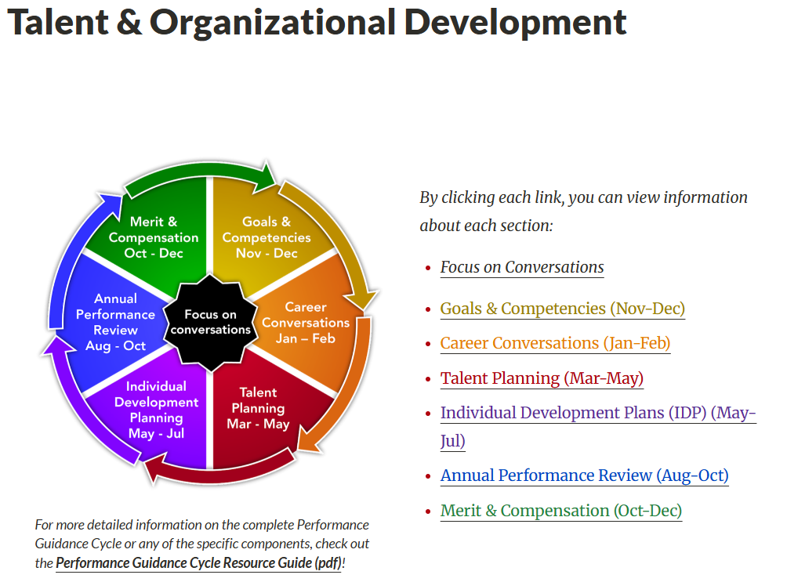
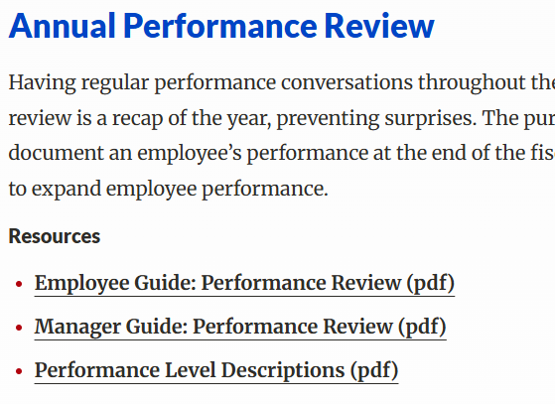
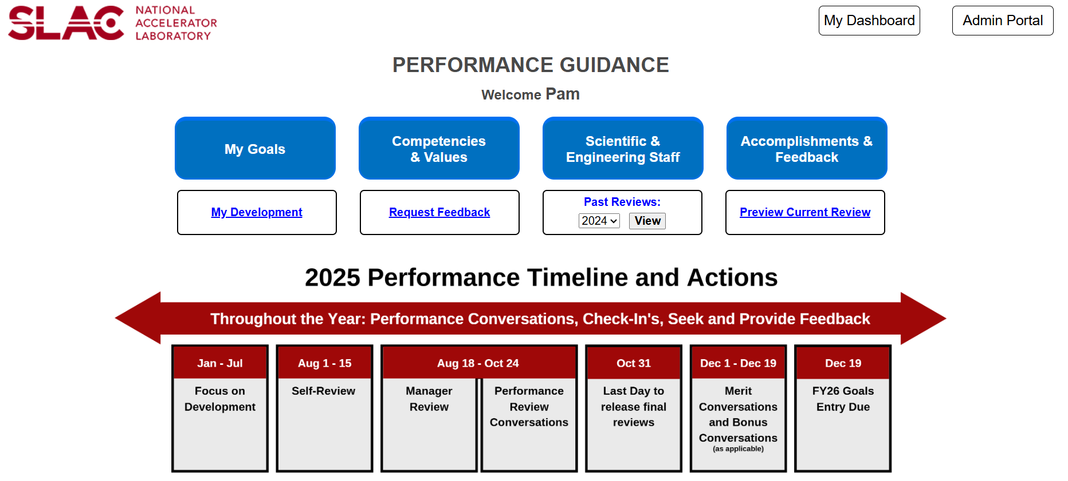
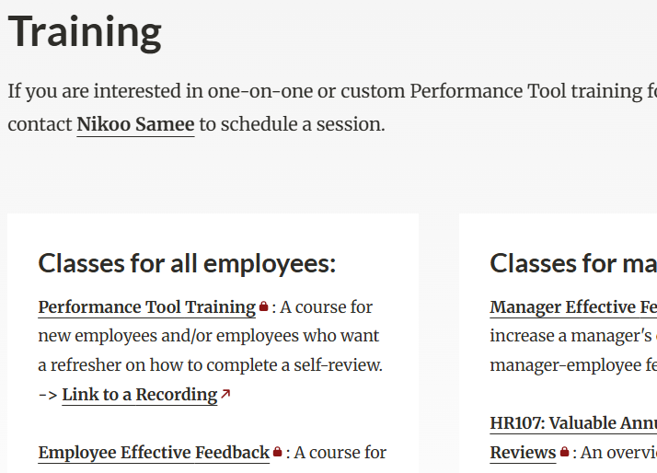
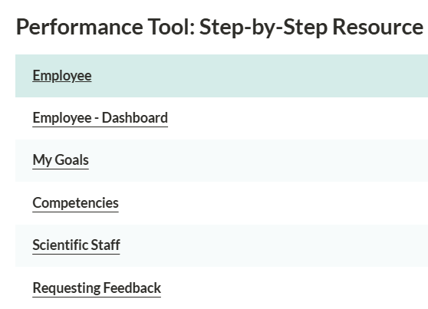
Additional Performance Guidance Resources
Talent & Organization Development website
Guides
Resources
Tool

Slide 4
Effective feedback increases engagement
What should the performance review do?
Provide an honest and respectful assessment of performance for continuing development
Increase workforce assessment and planning accuracy
Align, engage and motivate a highly skilled workforce
Recognize the “skill versus challenge” gap and provide support
Focus feedback conversations on goals and competencies, for self and manager reviews, throughout the year
What behaviors and practices contributed to achieving these results?
Looking back, what could have been done differently to achieve even greater results?
How and where can this learning be applied going forward?

